Slide 1
What are the characteristics of High-Rated Most-Popular Apps?
A Case Study on MOBILE Applications

Slide 2


Reminder: What this project is about

Slide 3
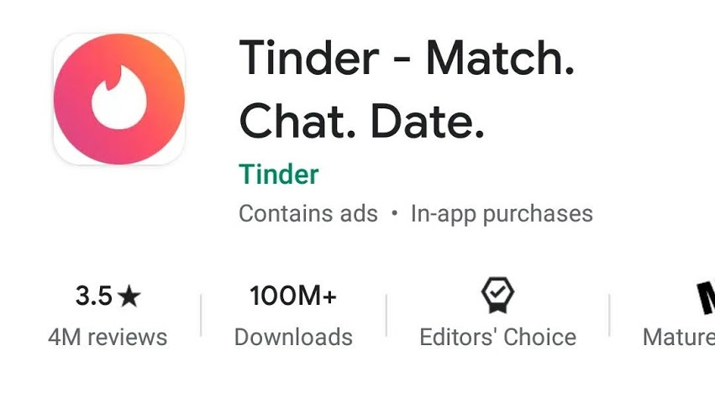
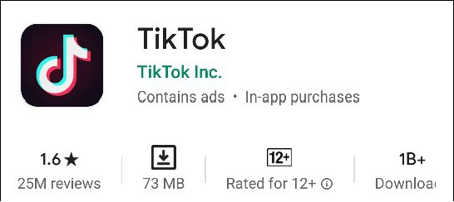
High-Rated Apps vs Most-Popular Apps
Apple Music – 3.1 with 50M + downloads
Google Classroom – 2.5 with 100M+ downloads
McDonalds Canada – 3.0 with 1M+ downloads

Slide 4
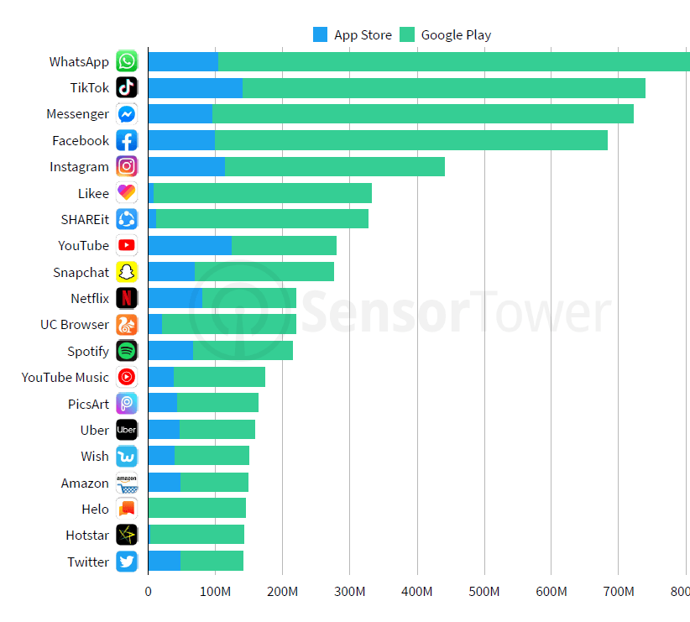
Most-downloaded apps overall worldwide, 2019

Slide 5
Research Questions
Is there a relationship between each factor and number of downloads?
What are the important factors that could indicate, with high probability, that an app will have a high number of downloads?
What is the difference between the characteristics of the Most-Popular Apps vs the characteristics of High-Rated Apps

Slide 6
Google Play Download Ranges
1-5
5-10
10-50
50-100
100-500
500-1000
1000-5000
5000 - 10000
10000 - 50000
50000 - 100000
100000 - 500000
500000 - 1000000
1000000 - 5000000
5000000 - 10000000
10000000 - 50000000
50000000 - 100000000
100000000 - 500000000
500000000 - 1000000000
1000000000 - 5000000000

Slide 7
Methodology/ Approach

Slide 8
My Dataset
We consider multiple sources
All in all, our final dataset comprises of more than 80,000 applications
We filter apps with less than 100 downloads
Top 10% apps are considered as highly-downloaded apps or most popular apps and the bottom 10% apps are considered as less-downloaded apps or least popular apps

Slide 9
Category Distribution in the given dataset

Slide 10
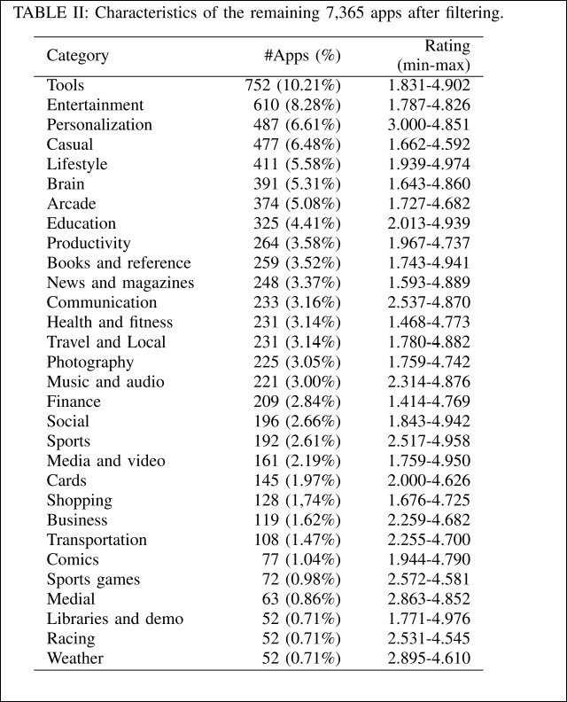
Category Distribution Comparision

Slide 11
Survey
Aim: To identify factors affecting number of downloads
Audience: End Users
Method: Email
Input: 5 choices from most likely to least likely

Slide 12
Results

Slide 13
Some other Interesting Insights
What types of apps are more likely to be downloaded?
1. Communication
2. Tools
3. Media and Video
4. Social, Shopping
iOS users are more likely to pay than Android users

Slide 14
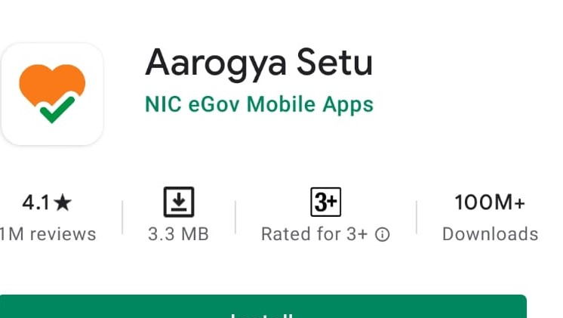
Learnings
In the real world, there are lot of factors that affect the number of app downloads. Some of the ones, I identified are:
Government Regulations
Public Perception

Slide 15
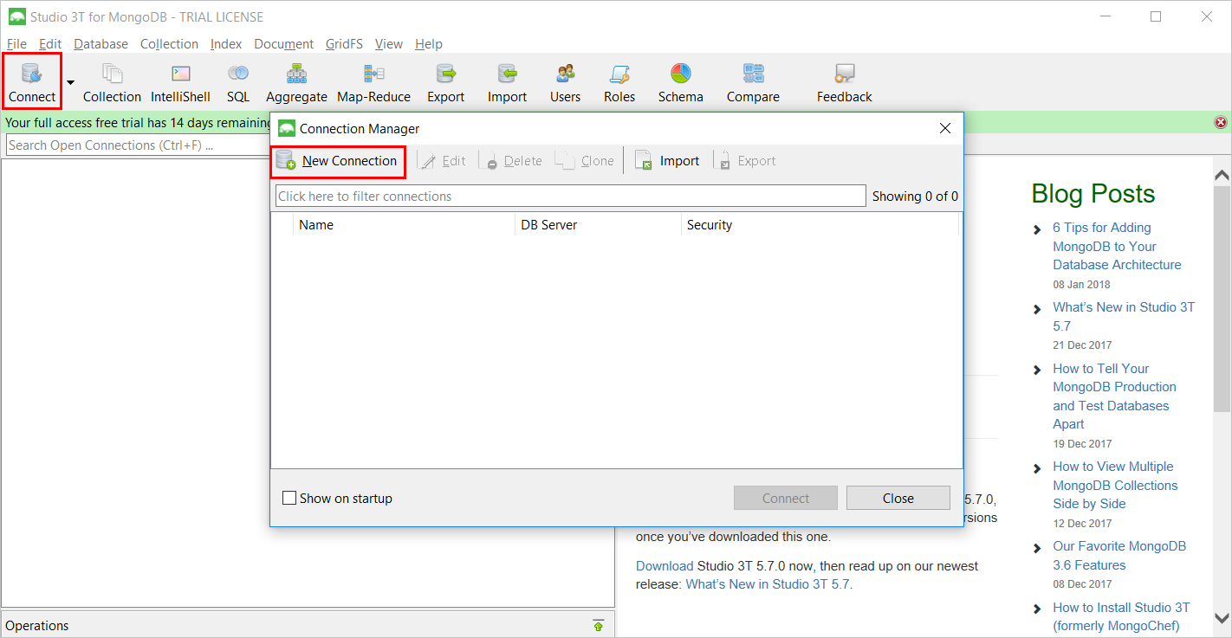
Challenges
Dealing with Large Dataset
Suggested Solution: Utilizing GUI tools like Studio 3T
Finding Relevant API

Slide 16

Future Work
More Factors
Studying more factors to determine if a relationship exists
APK files
Analyzing APK files for understanding internal factors like code complexity and size of activities and libraries

Slide 17
Thank You

